Slide 1
Student Performance Based on Habits
By Joshua Ruiz

Slide 2
The Problem
Academic performance is influenced by more than just classroom instruction—it reflects a complex interplay of lifestyle habits, mental health, and daily behaviors. Educators and policymakers often lack data-driven tools to identify students at risk or to recommend personalized improvements. By leveraging machine learning to model the relationship between exam performance and factors like study hours, sleep, diet, social media usage, and mental health, we can:
Uncover hidden patterns that traditional analysis may miss.
Support targeted interventions, such as promoting better study routines or mental wellness programs.
Empower students and advisors with actionable insights on habits that genuinely impact academic outcomes.
The goal of this study is to build a few predictive models that accurately estimates a student's exam score based on lifestyle habits, academic engagement, and well-being indicators. By analyzing factors such as study hours, social media usage, sleep patterns, diet quality, and mental health, I aim to identify the key drivers of academic performance and develop a data-driven tool to support student success interventions

Slide 3
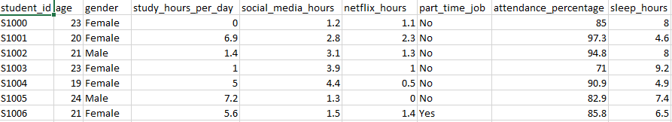
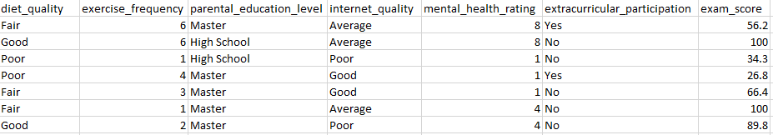
Data First Look
This is my data set that I am working with, with over 1000 entries

Slide 4
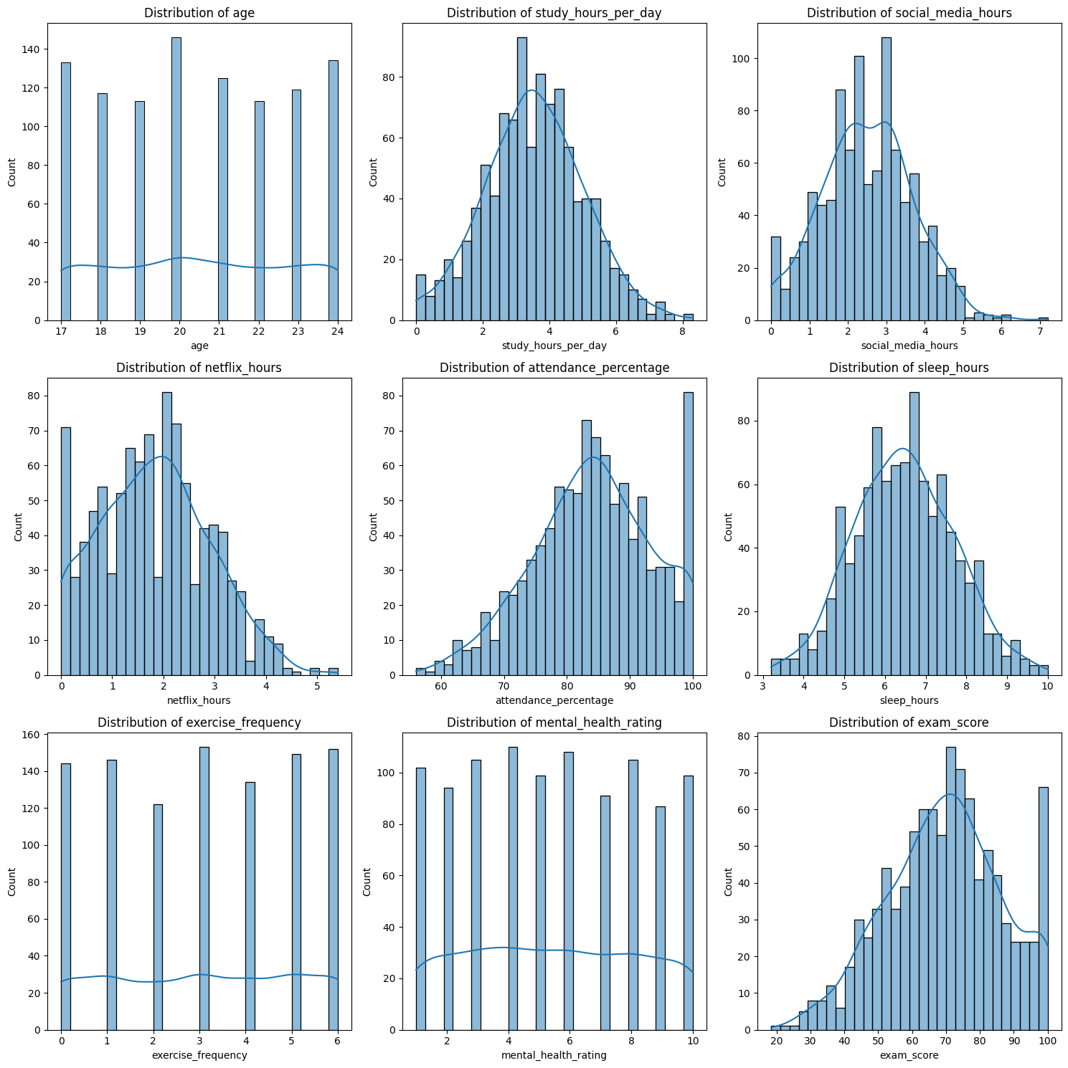
Data visualizations
This image presents a series of histograms illustrating the distribution of key numerical variables in the student habits dataset. Variables like study hours per day, sleep hours, and exam score show roughly normal distributions, indicating balanced data suitable for regression modeling. Features such as social media hours, Netflix hours, and attendance percentage are right-skewed, meaning most students spend relatively little time on those activities or maintain high attendance, with a few outliers on the higher end. Age, exercise frequency, and mental health rating appear uniformly or evenly distributed, with no dominant value, suggesting diverse behavioral patterns across the student population. Overall, the data exhibits healthy variability with few extreme skews, providing a solid foundation for predictive modeling.

Slide 5


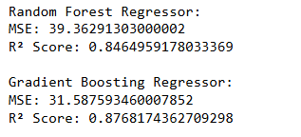
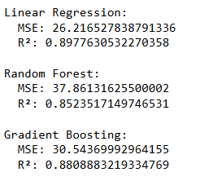
Modeling

Slide 6
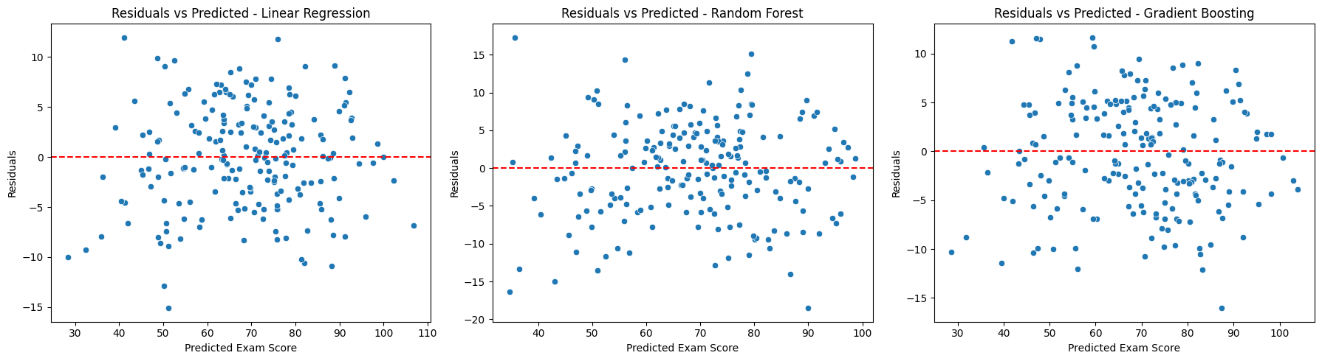
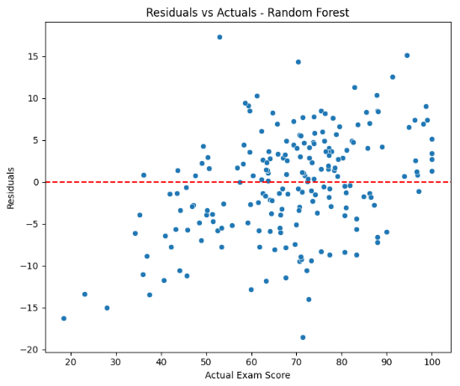
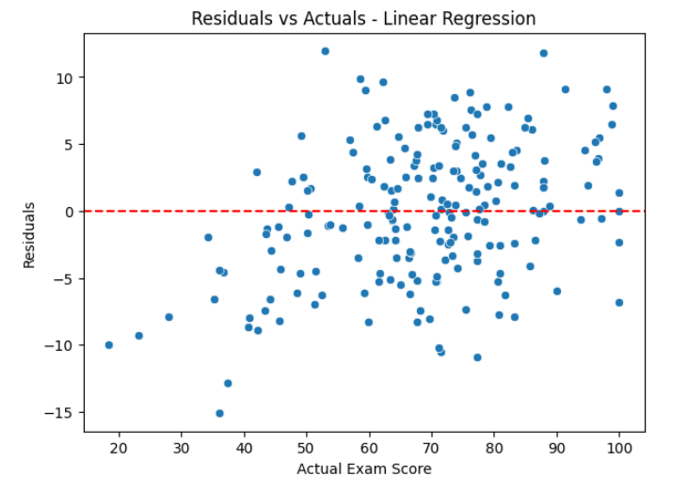
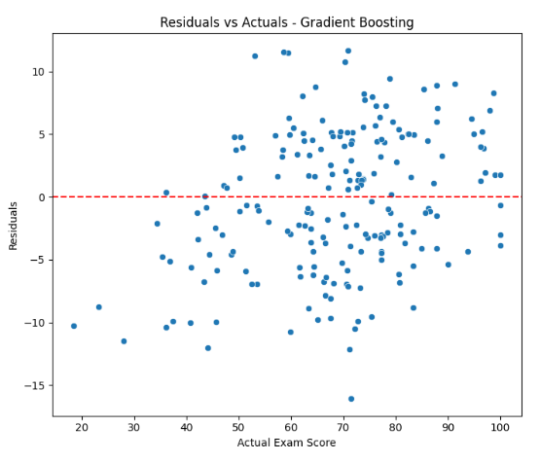
The Problem

Slide 7
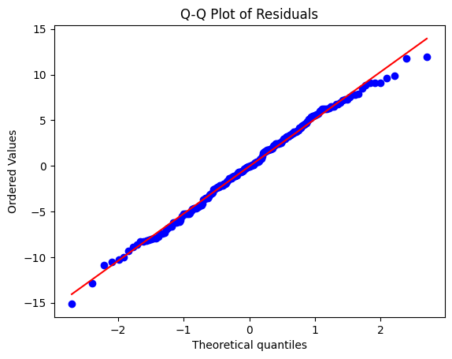
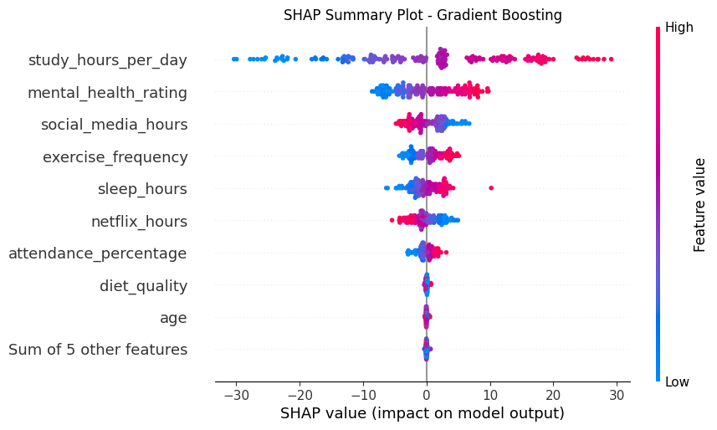
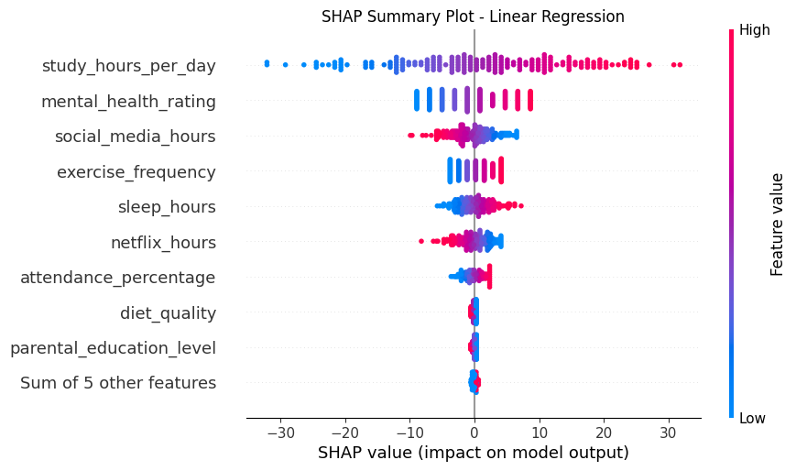
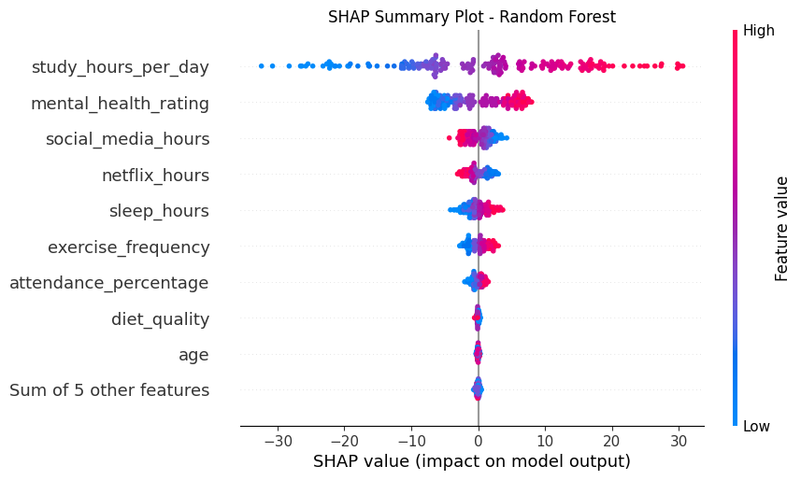
The Problem

Slide 8
Conclusion
Using data on student habits and lifestyle factors, we developed and compared three predictive models—Linear Regression, Random Forest, and Gradient Boosting—to estimate exam scores. Among them, Linear Regression performed best, achieving the lowest Mean Squared Error (26.22) and the highest R² score (0.898), indicating it captured the majority of variance in exam outcomes. Gradient Boosting and Random Forest followed closely but showed higher error levels. Key predictors included study hours, mental health ratings, and attendance percentage. The results suggest that even simple models can yield high predictive accuracy when the input data is clean, relevant, and linearly related to the outcome. These insights can help educators and advisors identify at-risk students and tailor interventions based on measurable habits and behaviors.

